Slide 1
Insertion Sort

Slide 2
Some Definitions
Internal Sort
The data to be sorted is all stored in the computer’s main memory.
External Sort
Some of the data to be sorted might be stored in some external, slower, device.
In Place Sort
The amount of extra space required to sort the data is constant with the input size.
2

Slide 3
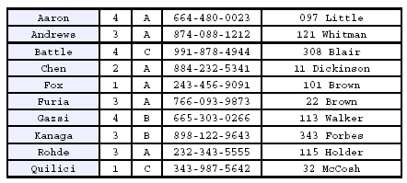
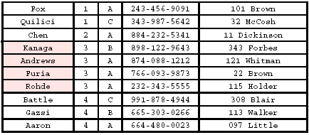
Stability
A STABLE sort preserves relative order of records with equal keys
Sorted on first key:
Sort file on second key:
Records with key value 3 are not in order on first key!! Not sorted with a stable algorithm
3

Slide 4
Insertion Sort
Idea: like sorting a hand of playing cards
Start with an empty left hand and the cards facing down on the table.
Remove one card at a time from the table, and insert it into the correct position in the left hand
compare it with each of the cards already in the hand, from right to left
The cards held in the left hand are sorted
these cards were originally the top cards of the pile on the table
4

Slide 5
Insertion Sort
To insert 12, we need to make room for it by moving first 36 and then 24.
6
10
24
36
12
5

Slide 6
Insertion Sort
6
10
24
36
12
6

Slide 7
Insertion Sort
6
10
24
36
12
7

Slide 8
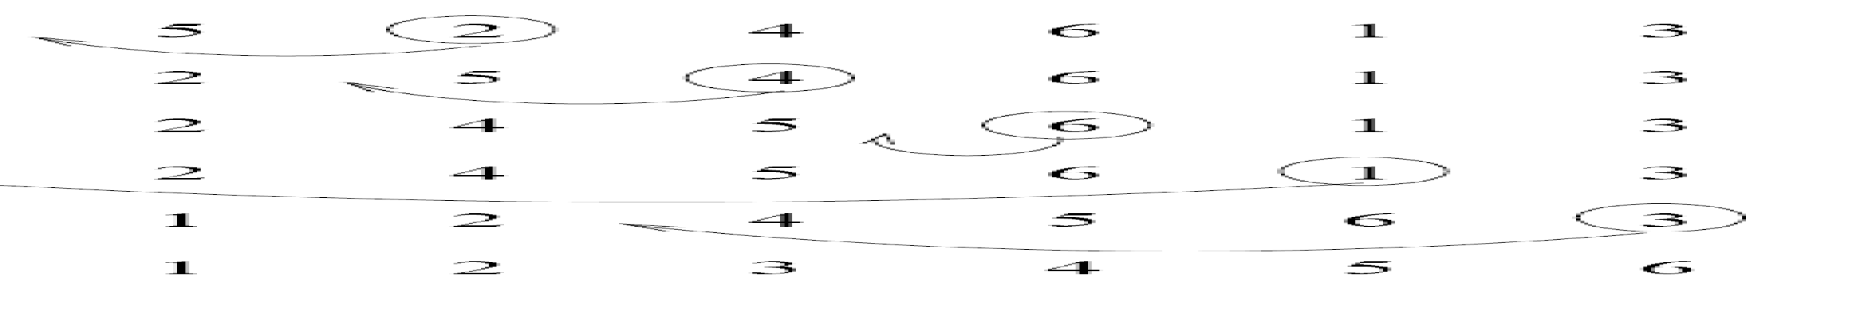
Insertion Sort
input array
5 2 4 6 1 3
at each iteration, the array is divided in two sub-arrays:
left sub-array
right sub-array
sorted
unsorted
8

Slide 9
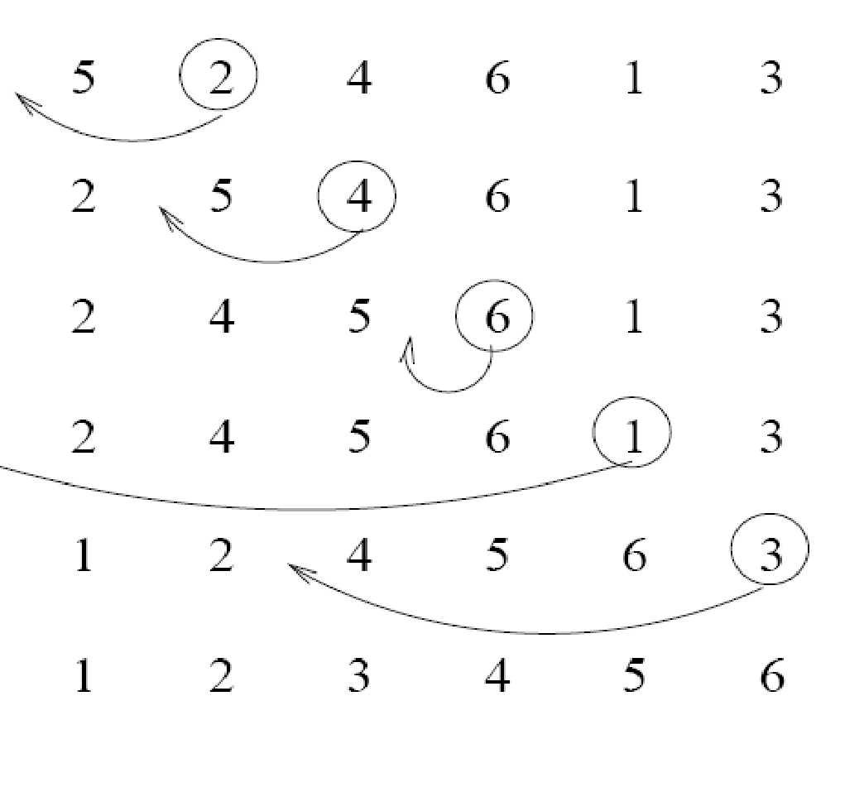
Insertion Sort
9

Slide 10
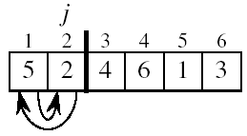
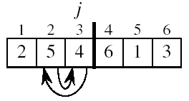
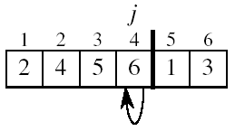
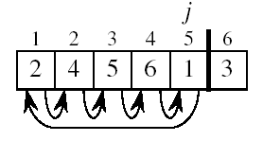
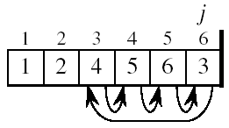
Insertion Sort
10

Slide 11
INSERTION-SORT
def insertionSort(list,n):
for (i = 1 to n-1):
key=list[i]
j=i-1
while (j>=0 and list[j]>key):
list[j+1] = list[j]
j -= 1
list[j+1] = key
11

